Slide 1
Leadership Journeys
Leadership Academy
July 30, 2025
Notes:
GBF 2.0
pw: moment
Video Clips: 43-47

Slide 2
Who’s in the room?
Start a conversation with someone at your table, using one another’s name tag as a prompt.

Slide 3

Who’s in the room?

Slide 4
Housekeeping
Restrooms
    1st Floor: 2 - next to mail room/nurse’s office (center of building)
Wifi
    New Boston Prep Main

Slide 5
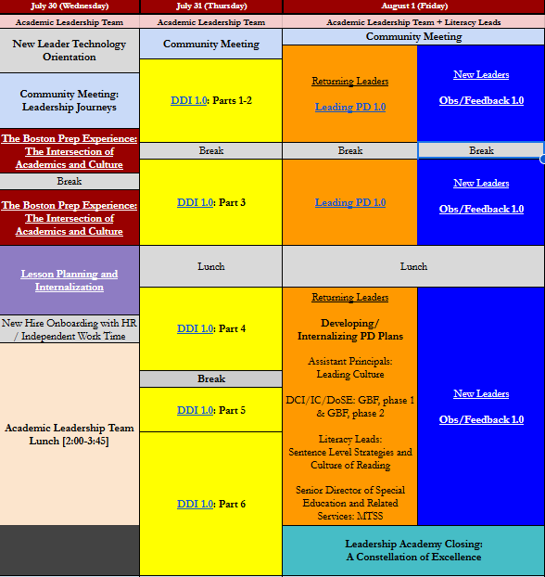
Leadership Academy Overview
Organized by “leadership levers”
Priority Levers:
  DDI
  Student Culture
Differentiation

Slide 6
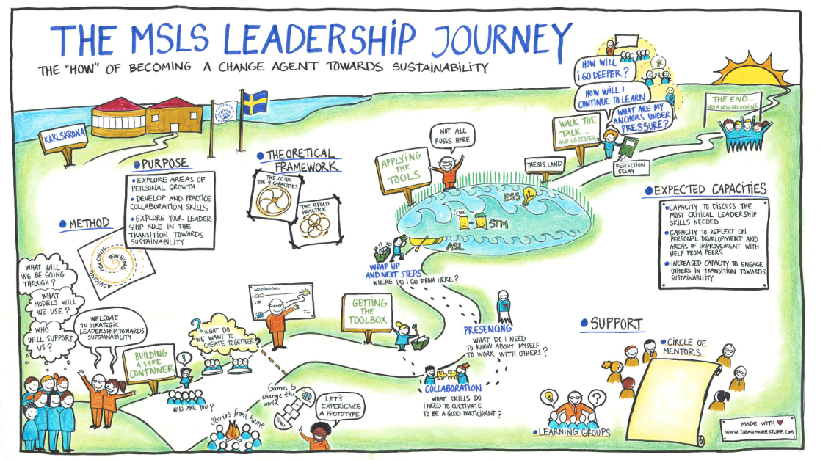
Leadership Journeys
Create a visual depiction of the leadership journey that has brought you here today.
Be as creative or literal as you’d like.
Create - 8 minutes
Partner Share - 8 minutes
Quad Share - 16 minutes

Slide 7

SY26 Leadership Theme
Analysis
Together we shine the way is an extended metaphor for the Academic Leadership Team members’ essential commitment to both individual strength and collaborative impact. If college is our north star, then the Academic Leadership Team is like a constellation. Each leader is like a star, strengthening their instructional leadership capacity to shine the way brighter for teachers. Our true impact, however, is dependent on the team’s overall strength and unity. Like a constellation, we must organize ourselves for consistency to shine the way for all of Boston Prep.

Slide 8


Individually we rise

Slide 9

Together we shine the way.

Slide 10

Give each other some shine.

Slide 11
The Boston Prep Experience: Intersection of Culture and Academics
Leadership Academy
July 30, 2025
Notes:
GBF 2.0
pw: moment
Video Clips: 43-47

Slide 12

Boston Prep Commitments
Which commitment will you lean into today?

Slide 13
Today’s Agenda
Part 1: Who we are.
Video
Portrait of a Graduate
Case Study
Beliefs about Teaching and Learning
Part 2: How we do it.
Instructional Coaching Vision
ALT Roles in Context
Scenarios
Core of Each Role
OBJECTIVES
LWBAT identify and discuss the overarching philosophies that guide our collective work
LWBAT explain the composition of the team and how it influences our daily work

Slide 14

20+ Years of the Phoenix
As you watch Boston Prep’s 20th Anniversary video, pay attention to what we value, both implicitly and explicitly, as a school.

Slide 15

Portrait of a Graduate
In my role as ___________________________, one way I can ensure students develop into tenacious learners / conscious contributors / creative problem solvers / independent thinkers is by _____________________________.

Slide 16

A Vignette: A Day in the Life
What do we value as a school? How do you know?

Slide 17

Beliefs about teaching and learning
Where do you see our values and our beliefs about teaching intersect?
What does living these beliefs look like in your daily work?

Slide 18

Part 2. How we do it.

Slide 19
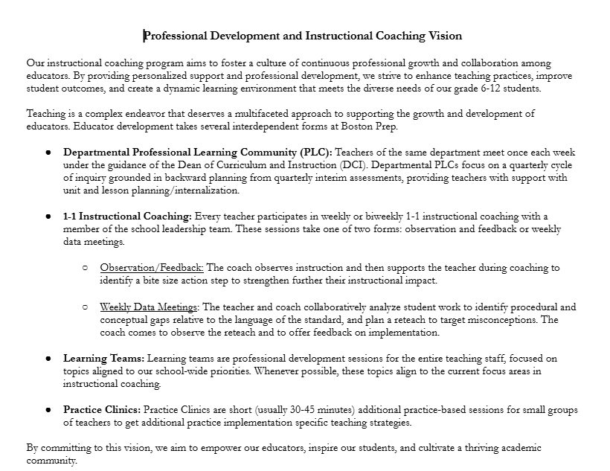
Instructional Coaching Vision
What’s familiar about our coaching vision?
What’s different or new?
How does our coaching vision reflect our mission, portrait of a graduate, and beliefs about teaching?

Slide 20
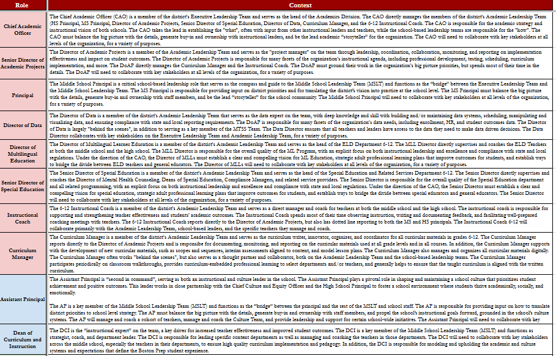
Academic Leadership Team: Roles in Context
How would you describe your role on the team?
What do you notice about the composition of our team?

Slide 21
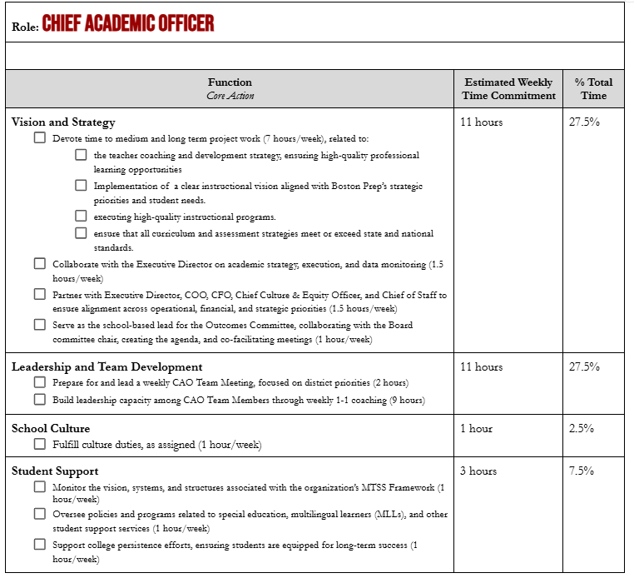
Academic Leadership Team: Core of Each Role
What do you notice about your work?
What connections do you see among the core of your role and…
our mission
our Portrait of a Graduate
our beliefs about teaching and learning?

Slide 22
Academic Leadership Team Scenarios
Who should be involved and why?
There’s a family town hall next week and you’d like to share some data on our priorities.
The 7th grade social studies teacher is struggling to engage a student productively in class. You’ve observed the class several times and noticed the student using avoidance behaviors, leading to almost zero work completion.
A new student enrolled in 9th grade English, and the teacher thinks the student should be receiving ELD supports, but he was not classified as a multilingual learner.
A math teacher is frustrated with his co-teacher, reporting that he “doesn’t do anything” in class. The co-teacher reported being frustrated that he “has nothing to do in class.”
There are space concerns regarding the upcoming interim assessment administration.

Slide 23
Academic Leadership Team Scenarios
Who should be involved and why?
A 12th grade student comes shares that he believes his credit history is inaccurate and that he is currently enrolled in the the wrong classes.

Slide 24

Closing Activity
In a few short days, new team members and returning team members will join us on campus. Write a thirty (30) second “Elevator Speech” introducing yourself, what you stand for, and its connection to Boston Prep’s mission and philosophies.

